Slide 1
Compass Lexecon Data Science Internship
23rd June 2022
Omotolani Kehinde-Osems

Slide 2
Data Preparation
The datasets provided contains scraped press releases from the European Commission. The files contain search results for the search term “competition”. Each file had at least 2,500 scraped html.
The goal of this project is to:
Compile data into a single clean dataset containing the content from all press releases and any relevant associated metadata.
Descriptive analysis of the dataset.
To answer the hypothesis question; is data and technology becoming more important in the EC’s competition enforcement?
Lastly, to identify potential areas of improvement and further analysis

Slide 3
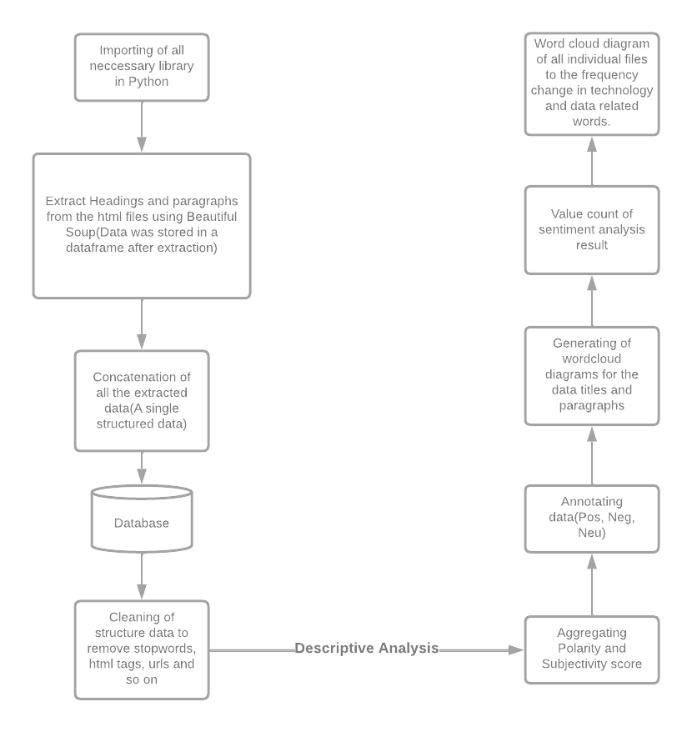
Process Flow

Slide 4
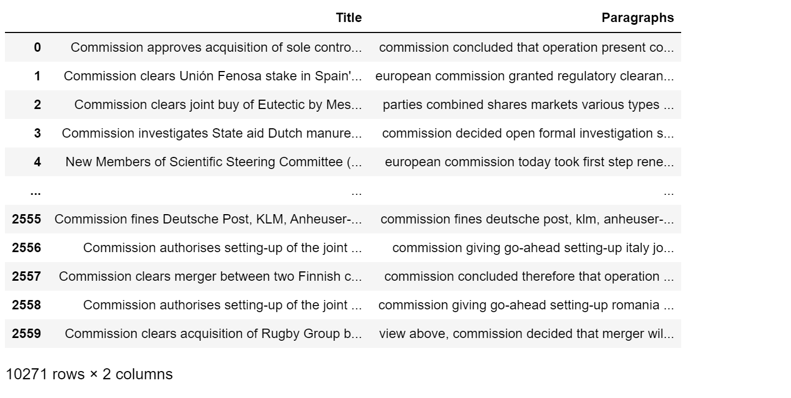
Data Preparation
Data was read into the required environment using a file reader function in python.
Glob was used to check for all the filenames where the pattern matches “.html”
All headings and paragraph was extracted from each HTML file using Beautiful soup and appended into a list.
The only paragraphs saved were paragraphs that had the word ‘competition’. This was done to streamline and focus on the requirements for this project.
Lastly the extracted data were cleaned and combined into a single structured dataframe.

Slide 5
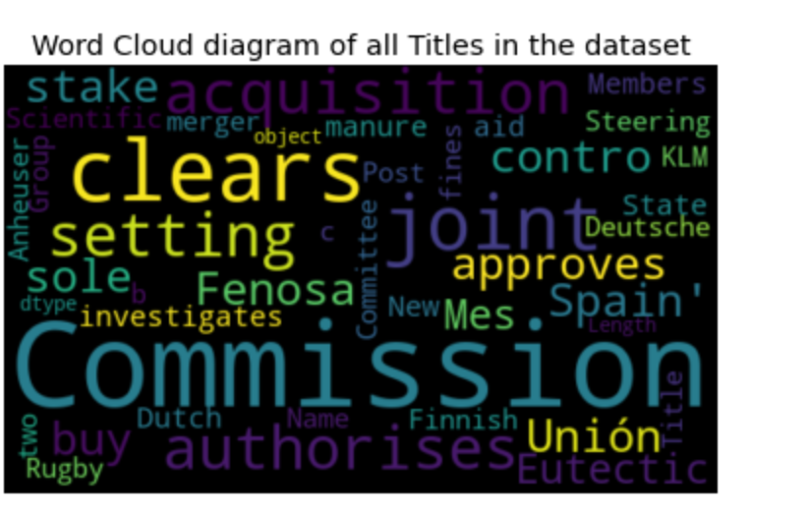
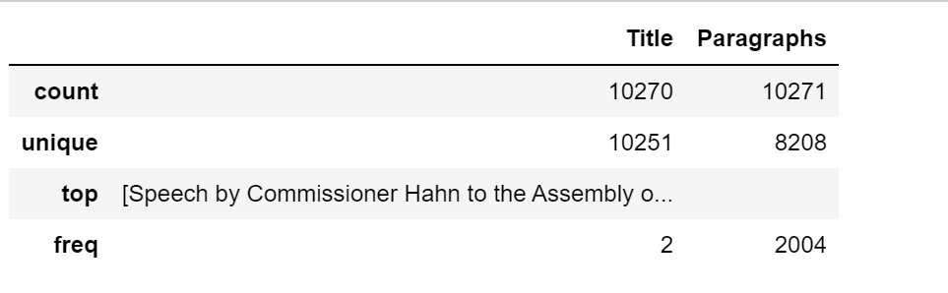
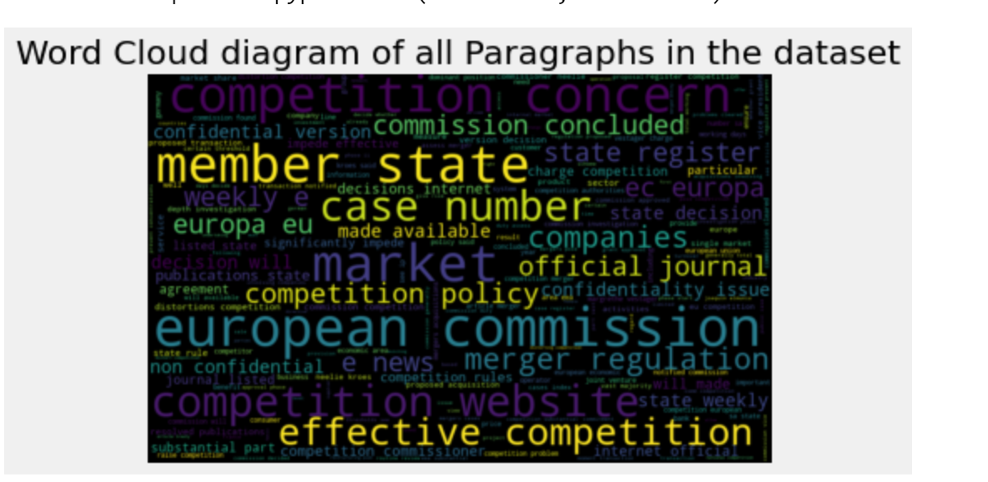
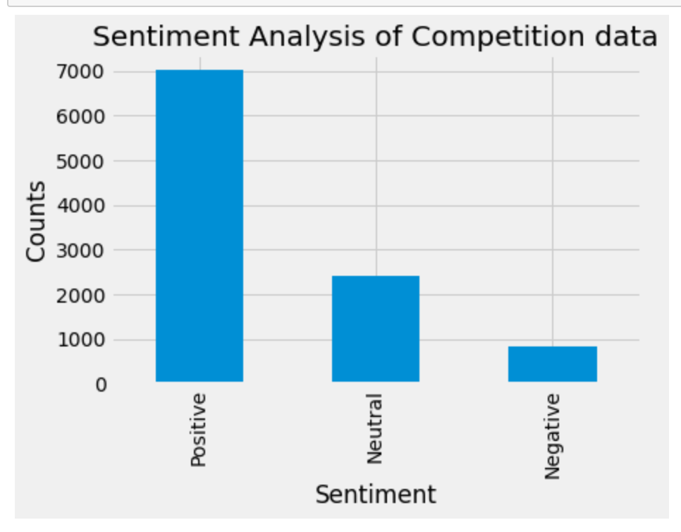
Descriptive Analysis
Sentiment and Word cloud analysis was picked as the analysis method because it provided insights about the most prominent policy areas by visualizing the word frequency in our text dataset(Merger and acquisition can be seen to be a very common policy area in the dataset).
Lastly, sentiment analysis was used to give an overview of the kind of articles. This helped to understand the big text data.

Slide 6
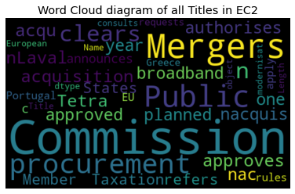
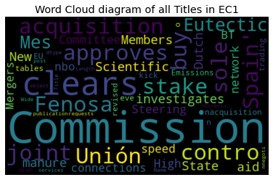
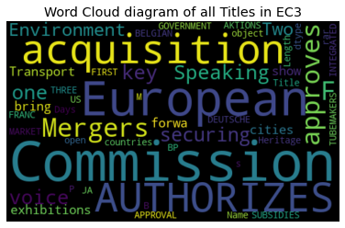
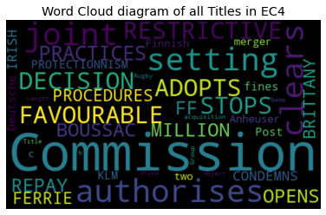
Is data and technology becoming more important in the EC’s competition enforcement?
This research question was answered by looking at the keywords in each html file and analysing the changes in competition issues over the years.
After a deep dive into the four batches of file, it was noticed that they had a date range between them where:-
EC press releases part 1 was from the year 2000 – 2005
EC press releases part 2 was from the year 2005 – 2011
EC press releases part 3 was from the year 1987 – 2011
EC press releases part 4 was from the year 1987 to 1999
A word cloud diagram was generated for each separate press release folder to see the changes in the keywords over the years. It can be seen that more technology related keywords like broadbands, networks, connections and so many others appeared in the most recent press release data(EC1 and EC2).
In conclusion, data and technology is becoming more important in the EC’s competition enforcement because more companies are becoming technology inclined.

Slide 7
Avenues for future analysis
A major avenue for future analysis will be a better extraction process where each date is captured for all the individual articles. This will improve the data analysis result of the project because so many more analysis can be more done to check the changes over time.
Also the text data generated over time can be trained to predict the type of competition issues that might arise over the coming years. This would help the EC’s competition enforcement team prepare or try to mitigate the risk from areas noted in the prediction results

Slide 8
Thank You.

